Slide 1


G.ro.me
Weekly Menu & Grocery planner
Start Date
04/ 14 / 17
Meals Per Day
5
Go

Slide 2





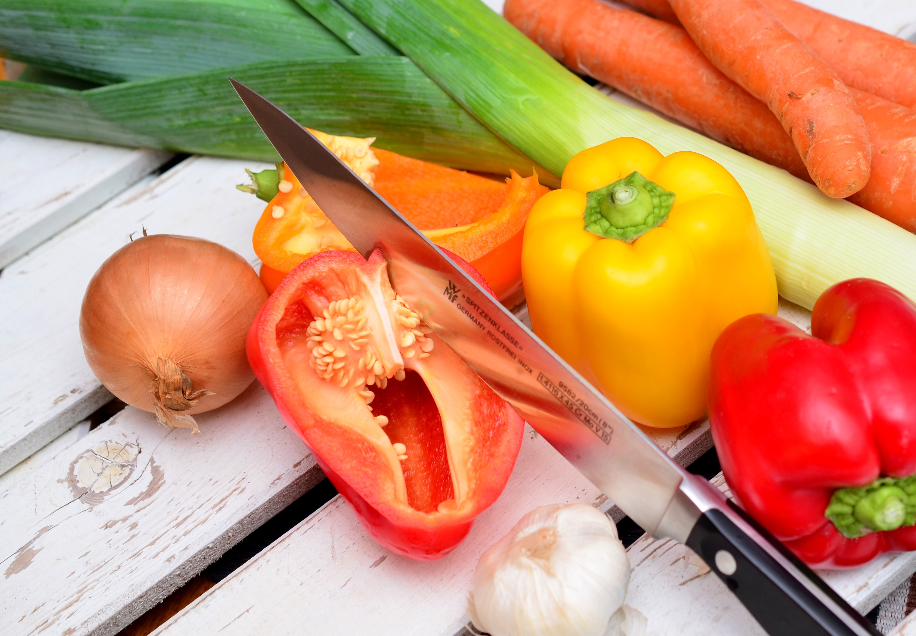
Web page title
http://www.url.com
G.ro.me
Start Date
04/ 14 / 17
Add Meal
 | Meal Type | FRI 04/14 | SAT 04/15 | SUN 04/16 | MON 04/17 | TUE 04/18 | WED 04/19 | THUR 04/20
X | …………… | Eat Out | Eat Out | Eat Out | Eat Out | Eat Out | Eat Out | Eat Out
X | …………… | Eat Out | Eat Out | Eat Out | Eat Out | Eat Out | Eat Out | Eat Out
X | …………… | Eat Out | Eat Out | Eat Out | Eat Out | Eat Out | Eat Out | Eat Out
X | …………… | Eat Out | Eat Out | Eat Out | Eat Out | Eat Out | Eat Out | Eat Out
X | …………… | Eat Out | Eat Out | Eat Out | Eat Out | Eat Out | Eat Out | Eat Out
Save Menu
Generate Groceries
Search Dishes
Meal Type
Select
Go
Go

Slide 3
Web page title
http://www.url.com
G.ro.me
Start Date
04/ 14 / 17
Add Meal
 | Meal Type | FRI 04/14 | SAT 04/15 | SUN 04/16 | MON 04/17 | TUE 04/18 | WED 04/19 | THUR 04/20
X | …………… | Eat Out | Eat Out | Eat Out | Eat Out | Eat Out | Eat Out | Eat Out
X | …………… | Eat Out | Eat Out | Eat Out | Eat Out | Eat Out | Eat Out | Eat Out
X | …………… | Eat Out | Eat Out | Eat Out | Eat Out | Eat Out | Eat Out | Eat Out
X | …………… | Eat Out | Eat Out | Eat Out | Eat Out | Eat Out | Eat Out | Eat Out
X | …………… | Eat Out | Eat Out | Eat Out | Eat Out | Eat Out | Eat Out | Eat Out
Save Menu
Generate Groceries
Search Dishes
Meal Type
Select
Go
Dish 1
Dish 2
Dish 3
Dish 4
Dish 4
Dish 5
Dish 6
Dish 7

